Slide 1
Present Tense -er and –ir verbs
Spanish 1
Unit 3

Slide 2
How do we conjugate –er and –ir verbs?

Slide 3
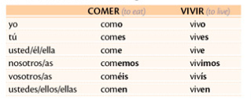

Slide 4
Useful –er and –ir verbs

Slide 5
Yo______ (beber) agua
beber

Slide 6
Tú______ (beber) Cocacola
beber

Slide 7
Nosotros ____ (beber) café en Starbucks
beber

Slide 8
El perro _______ (correr) en el parque.
correr

Slide 9
Usted_______ (correr) en la mañana.
CORRER

Slide 10
Mis amigos______ en la playa (the beach)
Correr

Slide 11
Yo_______ (vivir) en un apartamento
vivir

Slide 12
Tú______ (vivir) en una casa.
Vivir

Slide 13
Nosotras ____ en St. Louis.
vivir

Slide 14
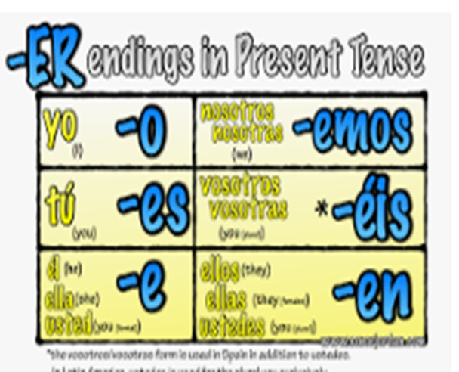
Do they have the same endings? Look closer!

Slide 15
Unit 3 What do I need to know for the test?
AUDIO La ropa vocab (femenino / masculino y plural/singular)
Descripciones vocab (bank of words)
La familia vocab SPELLING!
Possesive Adjectives (mi, tu, su etc) and when to use them
Árbol de la familia (family tree) very similar to the packet
Conjugations of –ER and –IR verbs (like in your worksheets)
Conjugations of SER and TENER (you already know them)
DESCRIBE MEMBERS of your family.
Build your own sentences using SER to describe personality and looks. Use TENER to describe age, pelo and ojos!

